Slide 1
Secure Data Hiding In Images Using Steganography
CAPSTONE PROJECT
Presented By: Nakum Raxeetkumar Vijaybhai
Student Name: Nakum Raxeetkumar Vijaybhai
College Name: Chandubhai S. Patel Institute of Technology
Department : Computer Science and Engineering

Slide 2
OUTLINE
Problem Statement
Technology used
Wow factor
End users
Result
Conclusion
Git-hub Link
Future scope

Slide 3
Problem Statement
Conventional encryption techniques can be easily identified, potentially drawing unwanted attention.
A discreet method is required to embed confidential messages within images securely.
Maintaining the original appearance of the cover image while ensuring data protection is essential.
Developing a user-friendly interface to enable encryption and decryption for non-technical users.

Slide 4
Technology used
Programming Language: Python
Image Processing Library: OpenCV
Graphical User Interface (GUI): Tkinter
File Handling & Security: Basic encryption logic for password protection
Platform: Windows 11
Additional Libraries: 1

Slide 5
Wow factors
Implements steganography to conceal messages within images without visible alterations.
Intuitive graphical interface for seamless encryption and decryption.
Ensures lossless data embedding by modifying pixel values instead of using conventional cryptography.
Supports all standard image formats, with PNG preferred for optimal quality.

Slide 6
End users
Cybersecurity Enthusiasts – Investigating advanced methods for secure communication.
Government & Defense Agencies – Transmitting confidential messages covertly.
Journalists & Whistleblowers – Protecting sensitive data from surveillance through image-based concealment.
Software Developers & Researchers – Understanding and implementing steganography techniques in real-world applications.

Slide 7
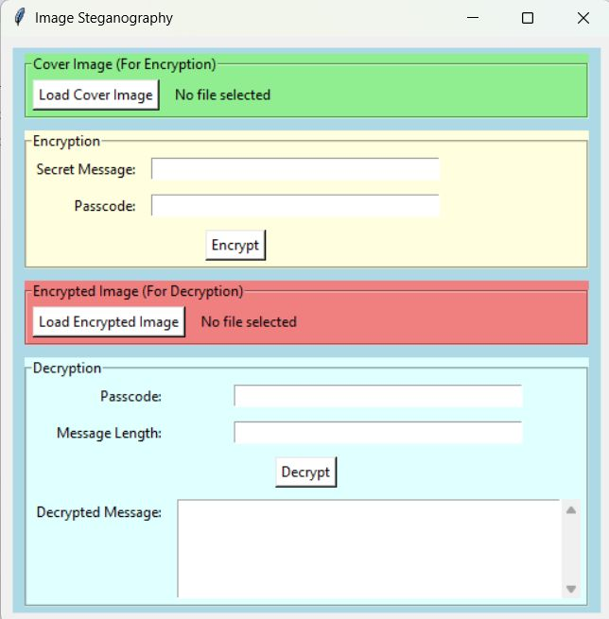
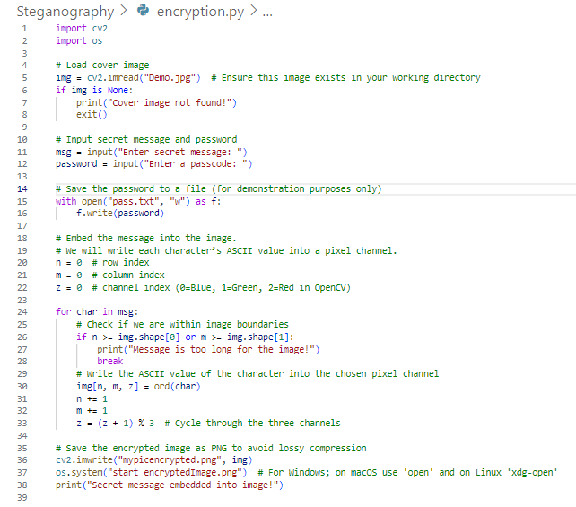
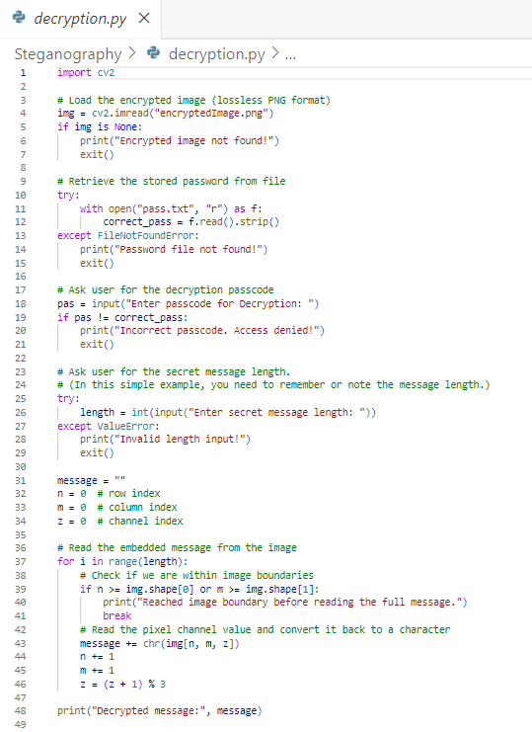


Results
GUI:
Encryption Code:
Decryption Code:
Input Image File:
Output Image File:

Slide 8
Conclusion
Steganography enables discreet transmission of confidential information.
This project demonstrates an efficient approach to embedding messages within images.
A user-friendly interface simplifies encryption and decryption for everyone.
Future enhancements can improve security, efficiency, and scalability.

Slide 9
GitHub Link
https://github.com/Raxnakum11/Steganography.git

Slide 10
Future scope
Advanced Encryption Techniques – Integrate AES encryption before embedding text in images.
Support for Audio & Video Steganography – Expanding beyond images.
AI-based Detection Prevention – Ensuring messages stay undetectable from modern forensic tools.
Mobile App & Web Version – Expanding accessibility beyond desktops.
Multi-Layer Security – Combining steganography with blockchain for ultra-secure communication.

Slide 11
THANK YOU

